Slide 1
Herb of the Year — Ginger Kathleen Harrington HSABR September 2023

Slide 2
Disclaimer
It is the policy of The Herb Society of America, Inc. not to advise or recommend herbs for medicinal or health use. This information is intended for educational purposes only and should not be considered as a recommendation or an endorsement of any particular medical or health treatment. Please consult a health care provider before pursuing any herbal treatments..

Slide 3
What is Ginger?

Slide 4
Common, or Culinary Ginger
Zingiber officinale
Flowering plant
Grown for its rhizome
Knotted, thick, beige underground stem
Relatives include turmeric, cardamom, and galangal

Slide 5
Growth Characteristics
Herbaceous perennial
Grows annual pseudostems about three feet tall

Slide 6
Growth Characteristics (continued)
Inflorescences rise directly from the rhizome on separate shoots
Bear flowers having pale yellow petals with purple edges

Slide 7
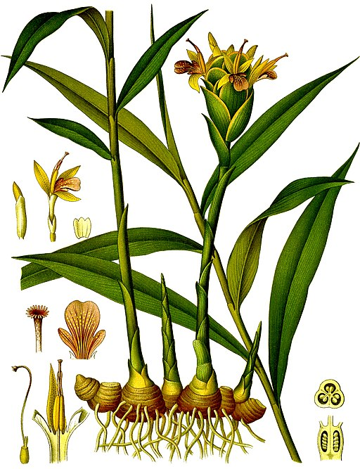
Zingiber officinale
1896 color plate from Köhler's Medicinal Plants

Slide 8
Harvesting Ginger
Rhizomes gathered when the stalk withers
Immediately scalded, or washed and scraped
Prevents sprouting
Ginger harvest in Myanmar

Slide 9
History of Ginger

Slide 10
Origin
Maritime Southeast Asia
True cultigen
Does not exist in a wild state
One of the first spices to have been exported from Asia over 5,000 years ago
Arrived in medieval Europe with the spice trade
Used by ancient Greeks and Romans
Brunei, Indonesia, Malaysia, the Philippines, Singapore, and East Timor

Slide 11
Ginger in Folk Medicine
Long history of use in Asian, Indian, and Arabic herbal traditions
Used in China to help digestion and treat stomach upset, diarrhea, and nausea for more than 2,000 years
Used by healers, monks, and herbalists in Europe to make tisanes, syrups, tinctures, and other carminative simples

Slide 12
Health Benefits of Ginger

Slide 13
Medicinal Properties
Fragrance and flavor of ginger are from its volatile natural oils and pungent phenolic compounds
Gingerol is the main bioactive compound

Slide 14
Current Medicinal Uses and Indications
Nausea Relief
Motion sickness
Pregnancy
Chemotherapy
Post-surgical
Osteoarthritis

Slide 15
Other Possible Benefits
May help lower cholesterol and help prevent blood clots
May help improve blood sugar control among people with type 2 diabetes
More research is needed to determine whether ginger is safe or effective for heart disease and diabetes

Slide 16
Other Possible Benefits (continued)
Bloating and gas
Can cut down on fermentation, constipation, and other causes of bloating and intestinal gas
Can help treat chronic indigestion
Wear and tear on cells
Contains antioxidants which help manage free radicals
May have anti-inflammatory properties

Slide 17
Other Possible Benefits (continued)
May help with weight loss
Possibly because of anti-inflammatory potential
May reduce menstrual pain
May help lower cholesterol levels
May help reduce risk of cancer
May improve brain function and protect against Alzheimer’s disease

Slide 18
Available Forms
Fresh or dried ginger root (rhizome)
Oil, steam distilled from the root
Powders, extracts, tinctures, capsules, and oils

Slide 19
How to Take Ginger
Pediatric use
DO NOT give ginger to children under 2 years of age
Children over 2 may take ginger to treat nausea, stomach cramping, and headaches
Ask your doctor to find the right dose

Slide 20
How to Take Ginger
Adult use
In general, DO NOT take more than 4 g of ginger per day, including food sources
Pregnant women should not take more than 1 g per day
For nausea, gas, or indigestion:
Some studies have used 1 g of ginger daily, in divided doses
Ask your doctor to help you find the right dose for you

Slide 21
How to Take Ginger
Adult use (continued)
For pregnancy-induced vomiting:
Some studies have used 650 mg to 1 g per day
DO NOT take ginger without talking to your doctor first
For arthritis pain:
One study used 250 mg, 4 times daily
Again, seek medical advice before starting

Slide 22
Precautions

Slide 23
Possible Adverse Effects
Although generally recognized as safe, ginger can cause heartburn and other side effects, particularly if taken in powdered form
May adversely affect individuals with gallstones
May interfere with the effects of anticoagulants, such as warfarin or aspirin, and other prescription drugs
Always check with a healthcare professional before beginning any herbal supplement

Slide 24
Caveats
Many medical professionals say ginger supplements aren’t necessary
Recommend getting ginger’s benefits through food rather than pills that may contain other, unnoted ingredients
The supplement industry is not well regulated, and it can be hard for consumers to know the quantity, quality, and added ingredients in commercially available nutrition supplements
Make sure their potency and ingredients have been vetted by a third party, not just the manufacturer

Slide 25
Caveats (continued)
Not all “gingers” are edible
Some are toxic
Use caution when buying ornamental gingers from a nursery
To be sure your ginger is edible, buy rhizomes from a grocery store and grow your own!
Asarum caudatum, western wild ginger

Slide 26
Other Edible Zingibers

Slide 27
Beehive Ginger
Zingiber spectabile
Ginger wort, Malaysian ginger
Also has medicinal properties
Beehive ginger

Slide 28
Bitter Ginger
Zingiber zerumbet
Pinecone ginger, Lempoyang ginger, Shampoo ginger
Leaves and leaf stalks are also fragrant
Slightly bitter; occasionally used in food
Most common use of bitter ginger is in shampoo and conditioners
Bitter ginger

Slide 29
Myoga Ginger
Zingiber mioga
Japanese Ginger
Flowers and shoots used in cooking
Refreshing taste with a strong, piquant aroma
Myoga ginger

Slide 30
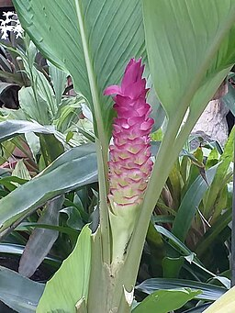
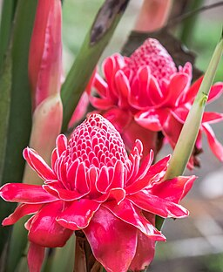
Edible Gingers in Other Genera
Crepe Ginger Cheilocostus speciosus
Hidden Ginger Curcuma petiolata
Torch Ginger
Etlingera elatior

Slide 31
Other Uses of Ginger

Slide 32
Culinary
Used in numerous forms, including fresh, dried, pickled, preserved, crystallized, candied, and powdered, or ground
The flavor is somewhat peppery and slightly sweet, with a strong and spicy aroma
Can be used in vegetable dishes, candy, soda, tea, marinades, etc.

Slide 33
Culinary (continued)
Concentration of essential oils increases as ginger ages
The intended use of the rhizome determines the time when it is harvested
Ginger harvested at 5 months is not yet mature
Thin skin; rhizomes are tender with a mild flavor and are best used in fresh or preserved forms
Often pickled in sweet vinegar, which turns it a pink color; popular with sushi and other Asian dishes

Slide 34
Culinary (continued)
For extracting the oil, ginger can be harvested at 9 months or longer
Ginger harvested at 8–9 months has a tough skin that must be removed before eating
More pungent; used dried or pulverized into ground ginger
Used in cookies, cakes, and curry mixes
Candied or crystallized ginger is cooked in sugar syrup and coated with granulated sugar

Slide 35
Beverages!
Ginger tea
Long history as a traditional herbal medicine in Asia
Settles stomach
Often flavored with orange peel, cloves, peppermint, etc. to counter bitterness

Slide 36
Beverages! (continued)
Used in England from around the middle of the 18th century to make an alcoholic beverage
Fermented with sugar, water, and a starter culture
Quenched thirst and quelled stomachs at the same time
Ginger beer, with and without alcohol, still used today

Slide 37
Fresh Ginger Tea (from Cookie + Kate)
Thinly slice fresh ginger
Use about a one-inch piece of ginger per cup of tea
In a saucepan, combine the ginger with 1 cup of fresh water per serving

Slide 38
Fresh Ginger Tea (from Cookie + Kate)
Bring the mixture to a boil over high heat
Reduce heat to maintain a gentle simmer
Simmer for five minutes
Up to 10 minutes for extra-strong tea
Strain through a fine sieve
Add lemon, honey, maple syrup, or cinnamon, if desired

Slide 39
Fresh Ginger Tea Recipe
Cookie + Kate

Slide 40
Ginger Bug (from HSA Blog)
Modern take on historic ginger “beer” or ginger “ale” drinks
Fermented
Does not contain a significant amount of alcohol
Slightly carbonated
Probiotic

Slide 41
Ginger Bug Recipe (from HSA Blog)
Materials needed:
Clean wooden spoon and 1-quart glass jar
2 large pieces fresh ginger rhizome, divided
½ cup sugar, divided
2 cups cold, non-chlorinated water

Slide 42
Ginger Bug Recipe (continued)
Peel (if the ginger is not organic) and grate 1 piece of ginger into the quart jar
Add 3 tablespoons of sugar and the water
Stir with a wooden spoon
Cover the jar with cheesecloth or a paper coffee filter secured with a rubber band
Set aside on countertop (do not refrigerate)

Slide 43
Ginger Bug Recipe (continued)
Every day for the next 5 days:
Stir the mixture and add 1 tablespoon grated ginger and 1 tablespoon sugar
Fermentation usually starts within 5 days, but it could take as long as 7 to 8 days
Continue to add grated ginger and sugar until fermentation begins
Mold should not appear, but if it does, scrape it off. If it recurs, start the process again

Slide 44
Ginger Bug Recipe (continued)
When fermentation starts, it’s ready to use
Bubbles, yeasty odor
Use right away or refrigerate

Slide 45
Ginger Bug Recipe (continued)
To use, strain the liquid using a fine mesh strainer and store it in a clean jar with a lid for up to 3 weeks, adding 1 teaspoon each of grated ginger and sugar once per week
Save grated ginger in a sealed container and use in recipes calling for fresh ginger or compost it
For fizzy drinks:
In a jug, combine ¼ cup strained Ginger Bug and 4 cups chilled mint or lemon herbal tea or fresh apple, peach, pear, or orange juice

Slide 46
Ginger Bug Recipe
Herb Society of America blog

Slide 47
Growing Ginger at Home

Slide 48
General Considerations
Plant in early spring after last frost
Cannot tolerate temperatures lower than 50°F
In the United States it can thrive year-round in zones 9 and higher
Parts of Florida, Southern California, Arizona, Hawaii, Southern Texas, and Louisiana
Baton Rouge is in Zones 8b–9a

Slide 49
Getting Started
Purchase “seed” ginger
Online seed company, local nursery, or grocery store
Organic is best; nonorganic often treated with growth inhibitor
Rhizomes should have smooth skin, light in color
Best: 4- to 6-inch-long piece with multiple fingers and a bud at the end of each
If buds have begun to turn green, so much the better

Slide 50
Getting Started
Cut the seed ginger roots into 1- to 2-inch-long pieces, each containing two or three nodules
Allow pieces to dry for 24 to 48 hours before planting

Slide 51
Soil
Loamy soil is ideal
Should contain equal amounts of sand, silt, and clay
Loose, and rich in organic matter
pH should be slightly acidic to almost neutral
(5.5 to 6.5)
Soil should be warm, between 71 and 77°F

Slide 52
Light
Choose a planting area that gets 2 to 5 hours of morning sun per day
In Zone 9 or higher, filtered sun all day
For growing ginger indoors, place the pot in a warm spot that gets plenty of indirect light

Slide 53
Planting
Plant ginger pieces in a pot or directly in loamy soil that is loose and fertile
If planting in a pot, choose one that is at least 12 inches deep and has ample drainage
Plant pieces 8 to 12 inches apart, 2 to 4 inches deep, with the nodules pointing upward
Spread a layer of mulch on top of the soil to keep it warm
Mulch also helps retain soil moisture

Slide 54
Water
Needs moist soil
Water immediately after planting
Keep soil moist by watering daily to prevent drying out
Replicates its natural tropical habitat
Reduce watering as the weather cools near the end of the growing season

Slide 55
Fertilize
Fertilize two to three times during the growing season
10-20-20 N-P-K blend
Lower nitrogen content dissuades the plant from focusing on its foliage
Encourages development of better rhizomes

Slide 56
Harvesting
Ginger typically requires 8–10 months to reach full maturity
If planted in spring, should be ready to harvest in late fall, before first frost

Slide 57
How to Harvest
Two ways:
1. Dig up the entire rhizome at any stage of the growth cycle
Cut off the stem, and rinse the rhizome under cool water
2. Cut off small pieces of the root as needed, keeping the plant alive
To remove just a piece, dig down around the rhizome and carefully cut off a section, leaving the remainder of the root in the ground
As long as a 2-inch or larger piece of rhizome remains attached to the stalk, it will continue to grow

Slide 58
Growing Ginger at Home
Bob Vila, Growing Ginger at Home
(Includes storage and propagation tips, as well as potential pests and diseases)

Slide 59
More About Ginger Than You Really Wanted to Know

Slide 60
Ginger References
Ginger Benefits
https://www.hopkinsmedicine.org/health/wellness-and-prevention/ginger-benefits
Ginger
https://www.mountsinai.org/health-library/herb/ginger
The Amazing and Mighty Ginger
https://www.ncbi.nlm.nih.gov/books/NBK92775/
11 Proven Health Benefits of Ginger
https://www.healthline.com/nutrition/11-proven-benefits-of-ginger
Varities of Ginger
https://www.urbanmali.com/blogs/wisdom/varieties-of-ginger

Slide 61
Ginger References
Wikipedia
https://en.wikipedia.org/wiki/Ginger
Which Gingers Are Edible?
https://www.thesurvivalgardener.com/which-gingers-are-edible/
Varities of Ginger
https://www.urbanmali.com/blogs/wisdom/varieties-of-ginger
How to Grow Ginger at Home
https://www.bobvila.com/articles/how-to-grow-ginger/

Slide 62
Thank you for coming!

